Slide 1



HUMAN POPULATION
LIVESTOCK POPULATION
τ
r_{H}
r_{A}
µ_{H}
Infected (I_{H})
Infected (I_{A})
µ_{A}
β_{HH}
β_{AA}
β_{HA}
β_{AH}
µ_{H}
φ
µ_{A}
µ_{H}
τ · θ
µ_{A}
Susceptible (S_{A})
Susceptible (S_{A})
β_{HA}
β_{AH}
β_{HH}
β_{AA}
µ_{H}
µ_{A}
Infected (I_{RH})
Infected (I_{RA})
r_{H}
r_{A}
Effect of Antibiotics
Antibiotic-Sensitive
Bacterial Transmission
Antibiotic-Resistant
Bacterial Transmission
Cross-Species
Transmission

Slide 2
HUMAN POPULATION
LIVESTOCK POPULATION
τ
r_{H}
r_{A}
I_{H}
I_{A}
µ_{H}
µ_{A}
β_{HH}
β_{HA}
β_{AH}
β_{AA}
µ_{H}
S_{H}
S_{A}
τ · θ
φ
µ_{A}
µ_{H}
µ_{A}
β_{HA}
β_{AH}
β_{HH}
β_{AA}
I_{RH}
I_{RA}
µ_{H}
µ_{A}
r_{H}
r_{A}
Effect of Antibiotics
Antibiotic-Sensitive
Bacterial Transmission
Antibiotic-Resistant
Bacterial Transmission
Cross-Species
Transmission

Slide 3
HUMAN POPULATION
LIVESTOCK POPULATION
τ · θ
r_{H}
r_{A}
I_{H}
I_{A}
µ_{H}
µ_{A}
β_{HH}
β_{HA}
β_{AH}
β_{AA}
µ_{H}
S_{H}
S_{A}
τ
φ
µ_{A}
µ_{H}
µ_{A}
β_{HA} · (1-α) · κ
β_{AH} · (1-α) · κ
β_{HH} · (1-α)
β_{AA} · (1-α)
I_{RH}
I_{RA}
µ_{H}
µ_{A}
r_{H}
r_{A}
Effect of Antibiotics
Antibiotic-Sensitive
Bacterial Transmission
Antibiotic-Resistant
Bacterial Transmission
Cross-Species
Transmission

Slide 4
HUMAN POPULATION
LIVESTOCK POPULATION
τ · θ
r_{H}
r_{A}
I_{H}
I_{A}
µ_{H}
µ_{A}
β_{HH}
β_{HA}
β_{AH}
β_{AA}
µ_{H}
S_{H}
S_{A}
τ
φ_{A}
µ_{A}
µ_{H}
µ_{A}
β_{HA} · (1-α)
β_{AH} · (1-α)
β_{HH} · (1-α)
β_{AA} · (1-α)
I_{RH}
I_{RA}
µ_{H}
µ_{A}
r_{H}
r_{A}
Effect of Antibiotics
Antibiotic-Sensitive
Bacterial Transmission
Antibiotic-Resistant
Bacterial Transmission
Cross-Species
Transmission

Slide 5
HUMAN POPULATION
LIVESTOCK POPULATION
τ · θ
r_{H}
r_{A}
I_{SH}
I_{SA}
µ_{H}
µ_{A}
ζ
β_{HH}
β_{HA}
β_{AH}
β_{AA}
µ_{H}
S_{H}
S_{A}
τ
φ
µ_{A}
µ_{H}
µ_{A}
β_{HA} · (1-α)
β_{AH} · (1-α)
ζ · (1-α)
β_{HH} · (1-α)
β_{AA} · (1-α)
I_{RH}
I_{RA}
µ_{H}
µ_{A}
r_{H}
r_{A}
Effect of Antibiotics
Antibiotic-Sensitive
Bacterial Transmission
Antibiotic-Resistant
Bacterial Transmission
Cross-Species
Transmission

Slide 6
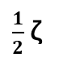
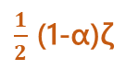
HUMAN POPULATION
LIVESTOCK POPULATION
τκ
r_{H}
r_{A}
I_{SH}
I_{SA}
µ_{H}
µ_{A}
$\frac{1}{2}$ζ
β_{HH}
β_{AA}
β_{HA}
β_{AH}
µ_{H}
S_{H}
S_{A}
τ
φ
µ_{A}
µ_{H}
µ_{A}
(1-α)β_{HA}
(1-α)β_{AH}
(1-α)β_{AA}
(1-α)β_{HH}
$\frac{1}{2}$ (1-α)ζ
I_{RH}
I_{RA}
µ_{H}
µ_{A}
r_{H}
r_{A}
Effect of Antibiotics
Antibiotic-Sensitive
Transmission
Antibiotic-Resistant
Transmission
Cross-Species
Transmission

Slide 7


HUMAN POPULATION
LIVESTOCK POPULATION
τκ
r_{H}
r_{A}
I_{SH}
I_{SA}
µ_{H}
µ_{A}
$$\frac{\text{ζ}}{2}$$
β_{HH}
β_{HA}
β_{AH}
β_{AA}
µ_{H}
S_{H}
S_{A}
τ
φ
µ_{A}
µ_{H}
µ_{A}
(1-α)β_{AH}
(1-α)β_{AA}
(1-α)β_{HA}
(1-α)β_{HH}
$$\frac{\text{(1−}\text{α}\text{)}\text{ζ}}{2}$$
I_{RH}
I_{RA}
µ_{H}
µ_{A}
r_{H}
r_{A}
Effect of Antibiotics
Antibiotic-Sensitive
Transmission
Antibiotic-Resistant
Transmission
Cross-Species
Transmission

Slide 8
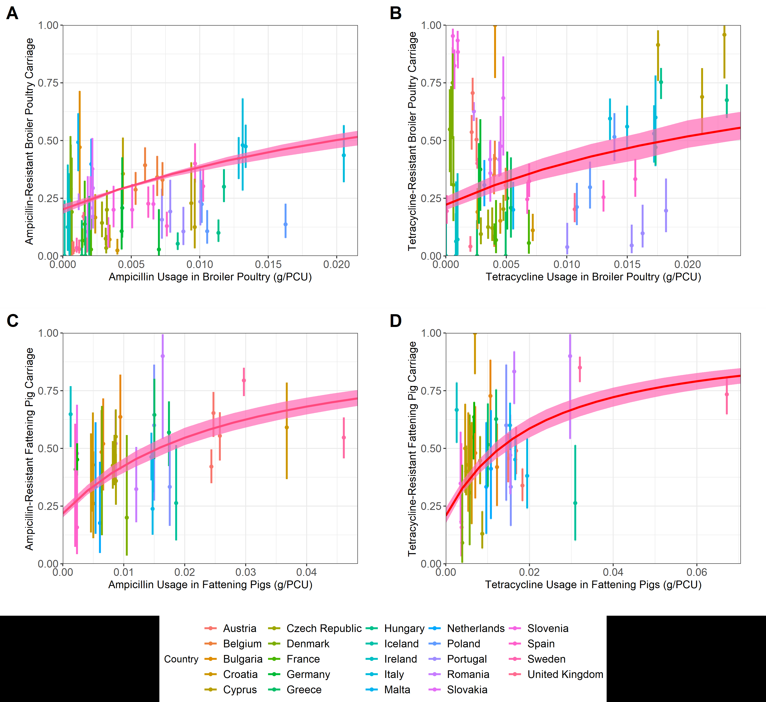

Slide 9
r_{H}
τ · θ
r_{A}
Infected (I_{SH})
Infected (I_{SA})
µ_{H}
µ_{A}
β_{AH}
ζ
β_{HH}
β_{AA}
Susceptible (S_{H})
Susceptible (S_{A})
µ_{H}
β_{HA}
τ
φ
µ_{A}
µ_{H}
β_{HA} · (1-α)
µ_{A}
ζ · (1-α)
β_{HH}·(1-α)
Infected (I_{RH})
Infected (I_{RA})
β_{AH} · (1-α)
β_{AA} · (1-α)
µ_{H}
µ_{A}
r_{H}
r_{A}
Effect of Antibiotics
Antibiotic-Sensitive
Bacterial Transmission
Antibiotic-Resistant
Bacterial Transmission
Cross-Species
Transmission

Slide 10
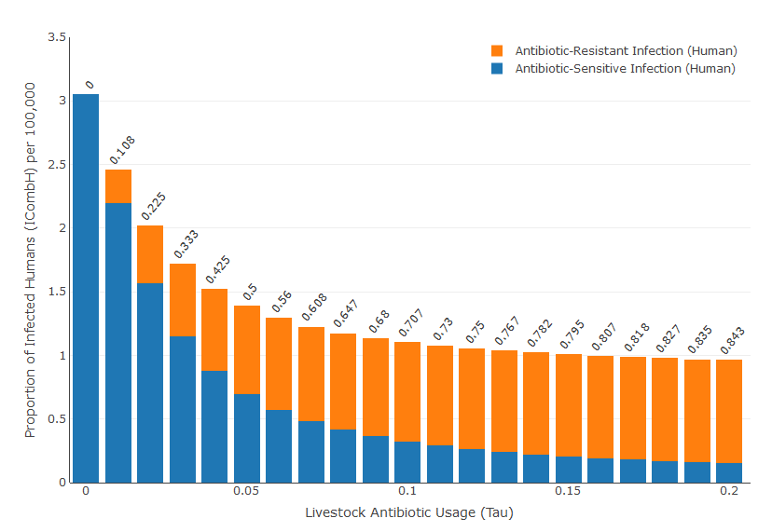


Slide 11
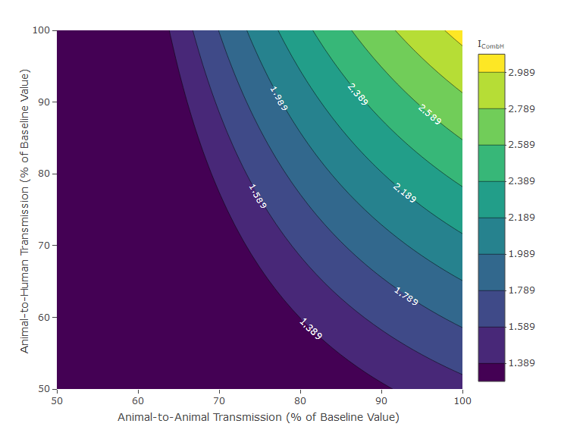

Slide 12
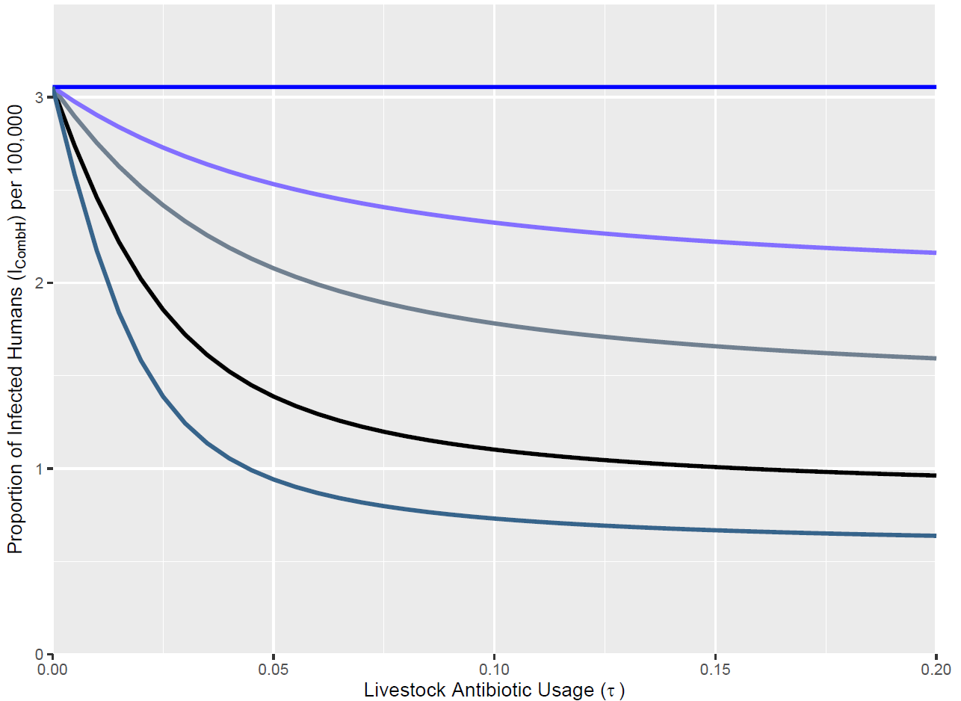
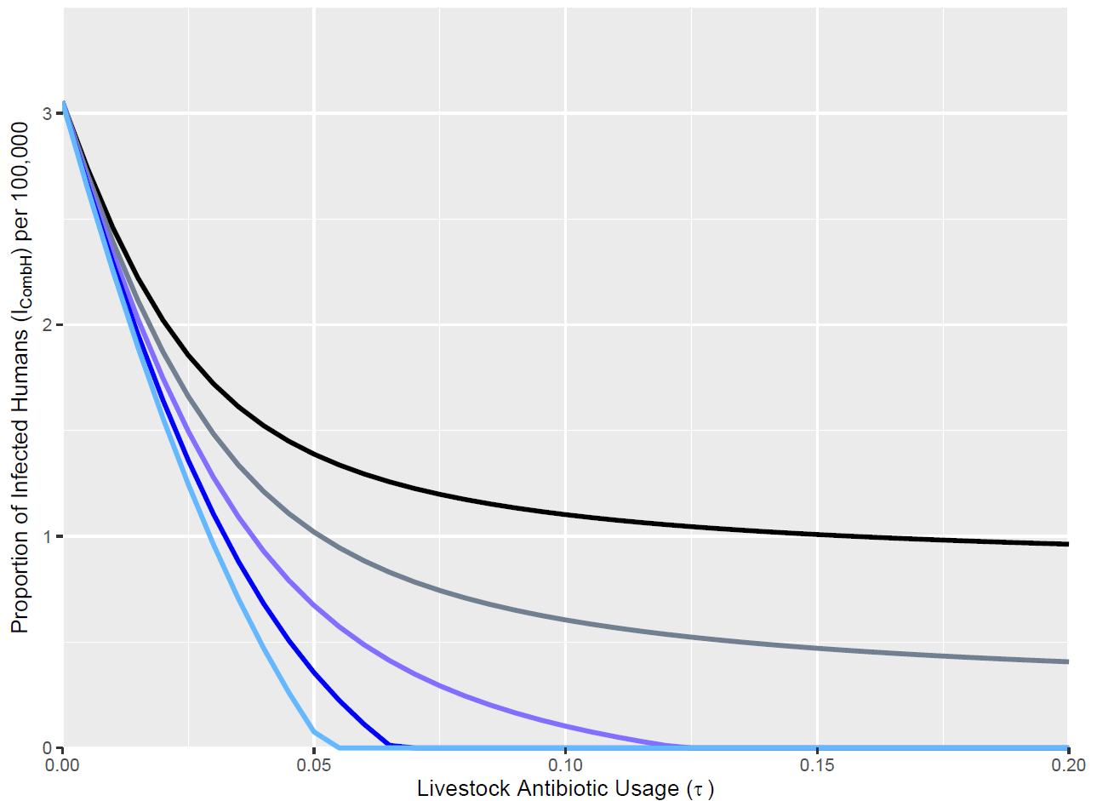
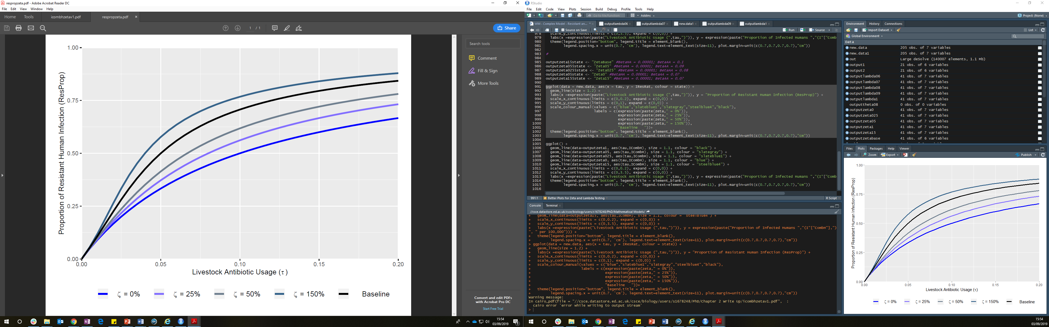
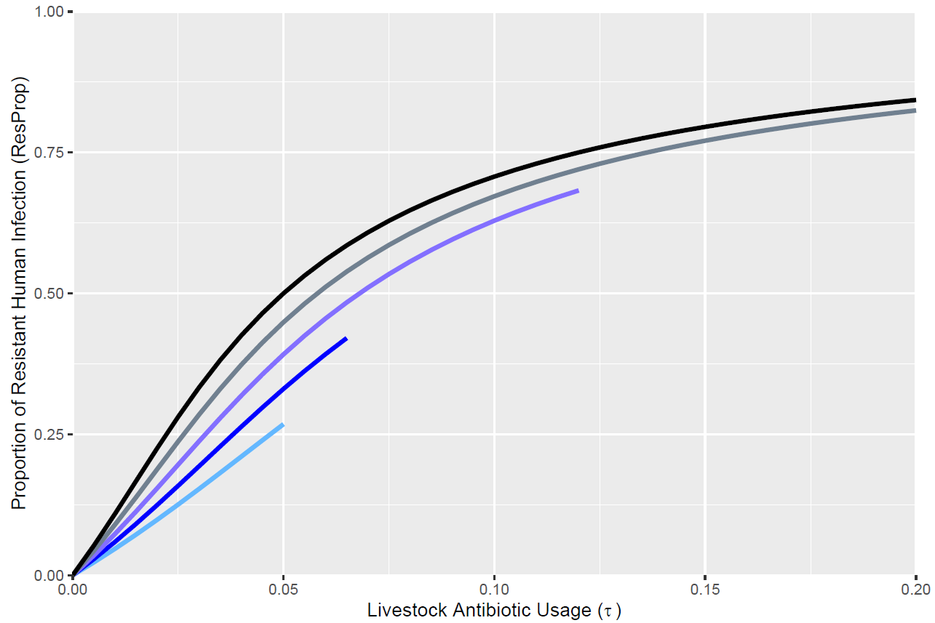
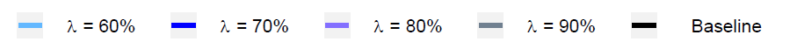
Efficacy of Livestock Antibiotic-Mediated Recovery (ζ)
Transmission Cost of Resistance (λ)
Overall Level of Resistant Human Infection
(I_{CombH})
Proportion of Resistant Human Infection
(ResProp)

Slide 13
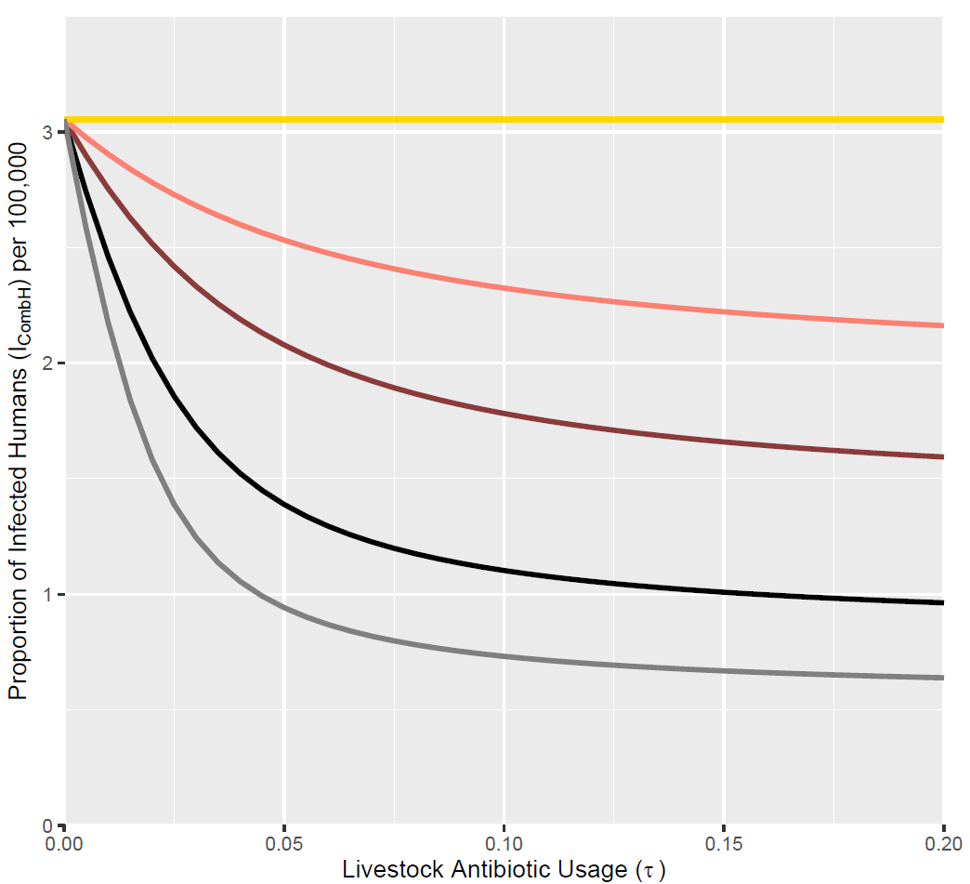
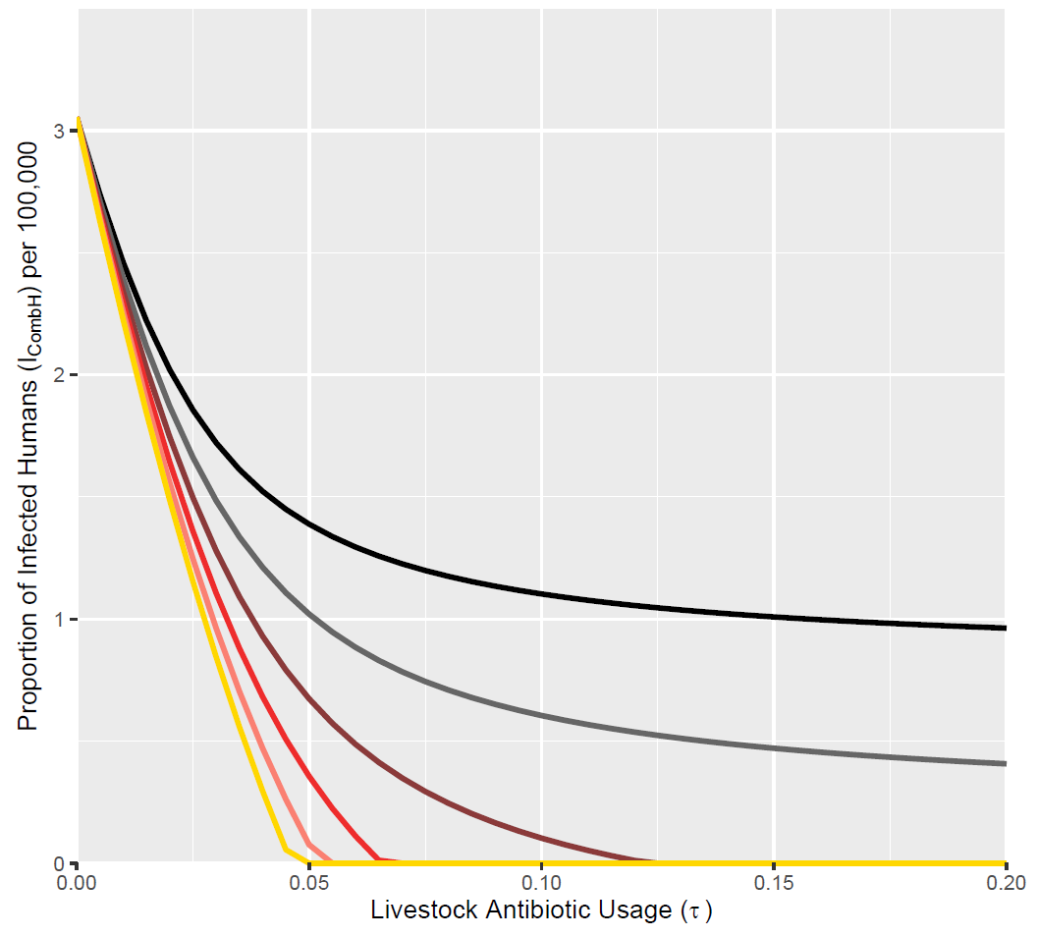
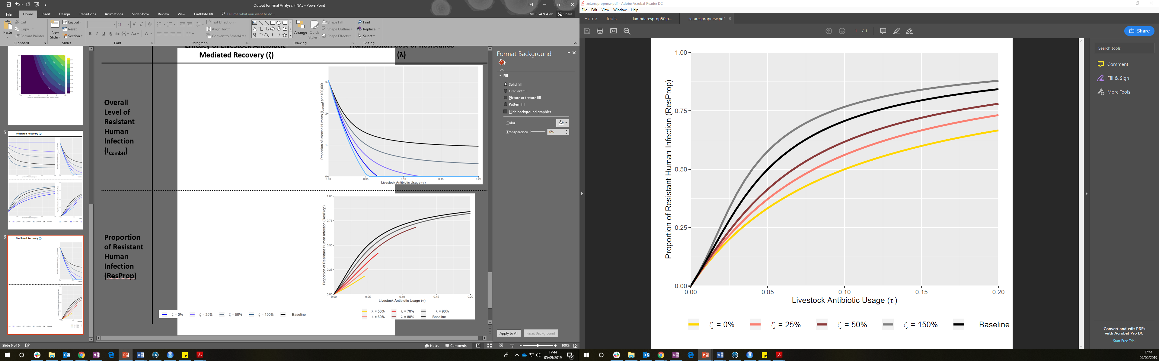
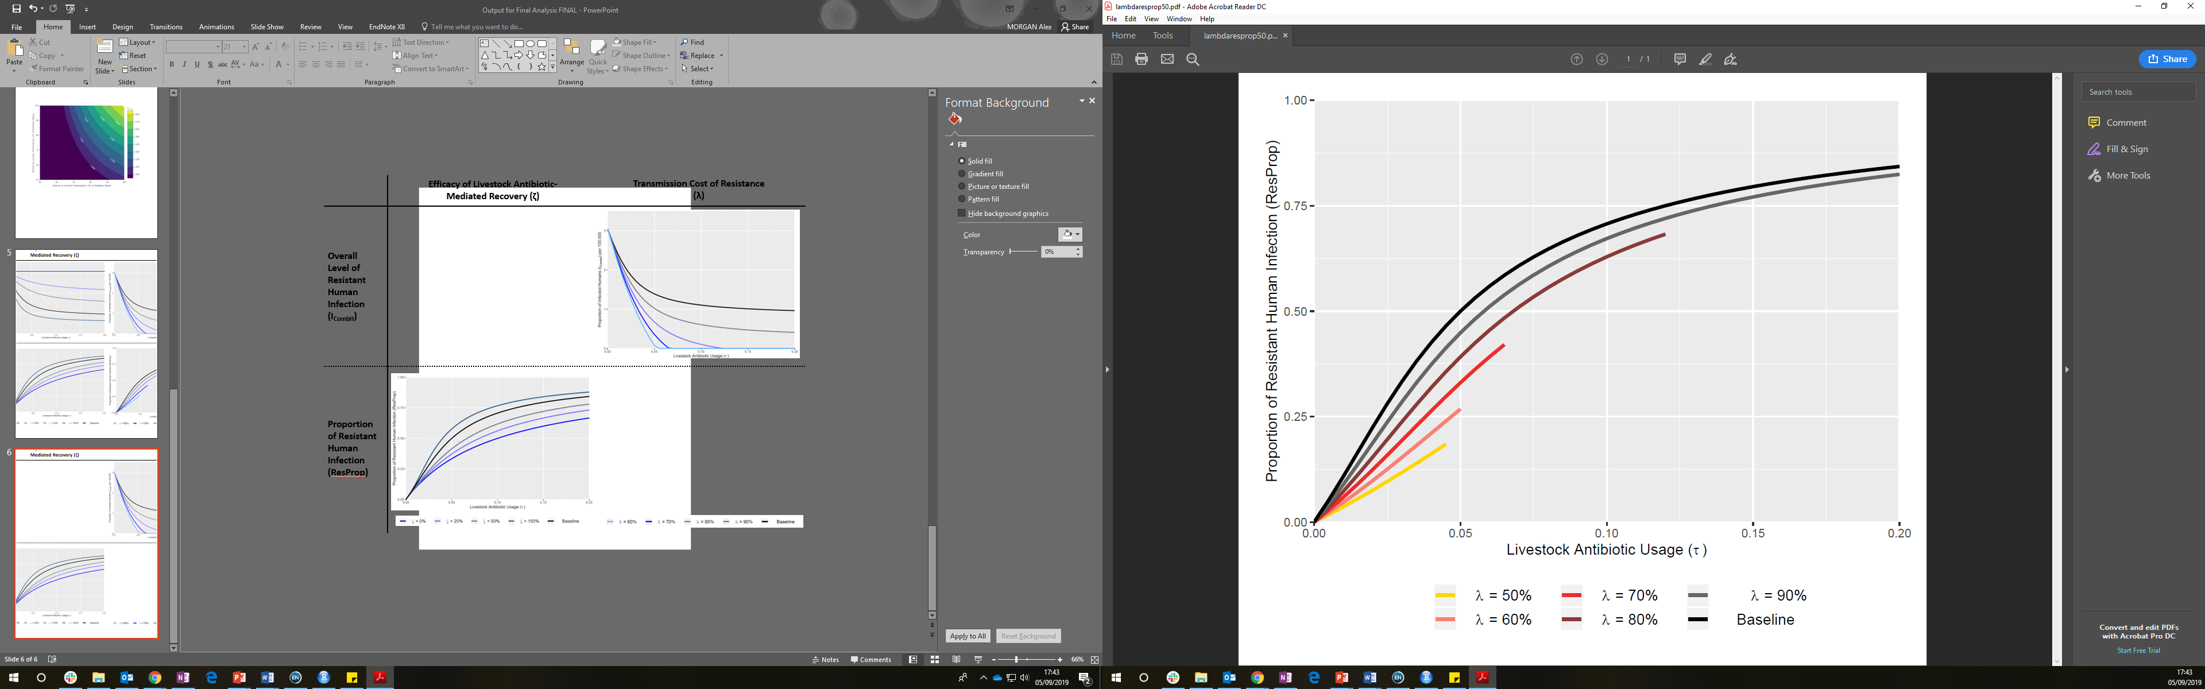
Efficacy of Livestock Antibiotic-Mediated Recovery (ζ)
Transmission Cost of Resistance (λ)
Overall Level of Resistant Human Infection
(I_{CombH})
Proportion of Resistant Human Infection
(ResProp)

